Slide 1

CHANGING THE WORLD OF FINANCE
Discussing FinTech
How technology has impacted our financial dealings

Slide 2
Points to discuss:
Table of Contents
About FinTech
A brief history of FinTech Cybersecurity as it relates to FinTech The bumps in the road for FinTech
The benefits of FinTech-driven payments The next chapter for FinTech
Tip: Use links to go to a different page inside your presentation.
How: Highlight text, click on the link symbol on the toolbar, and select the page in your presentation you want to connect.

Slide 3
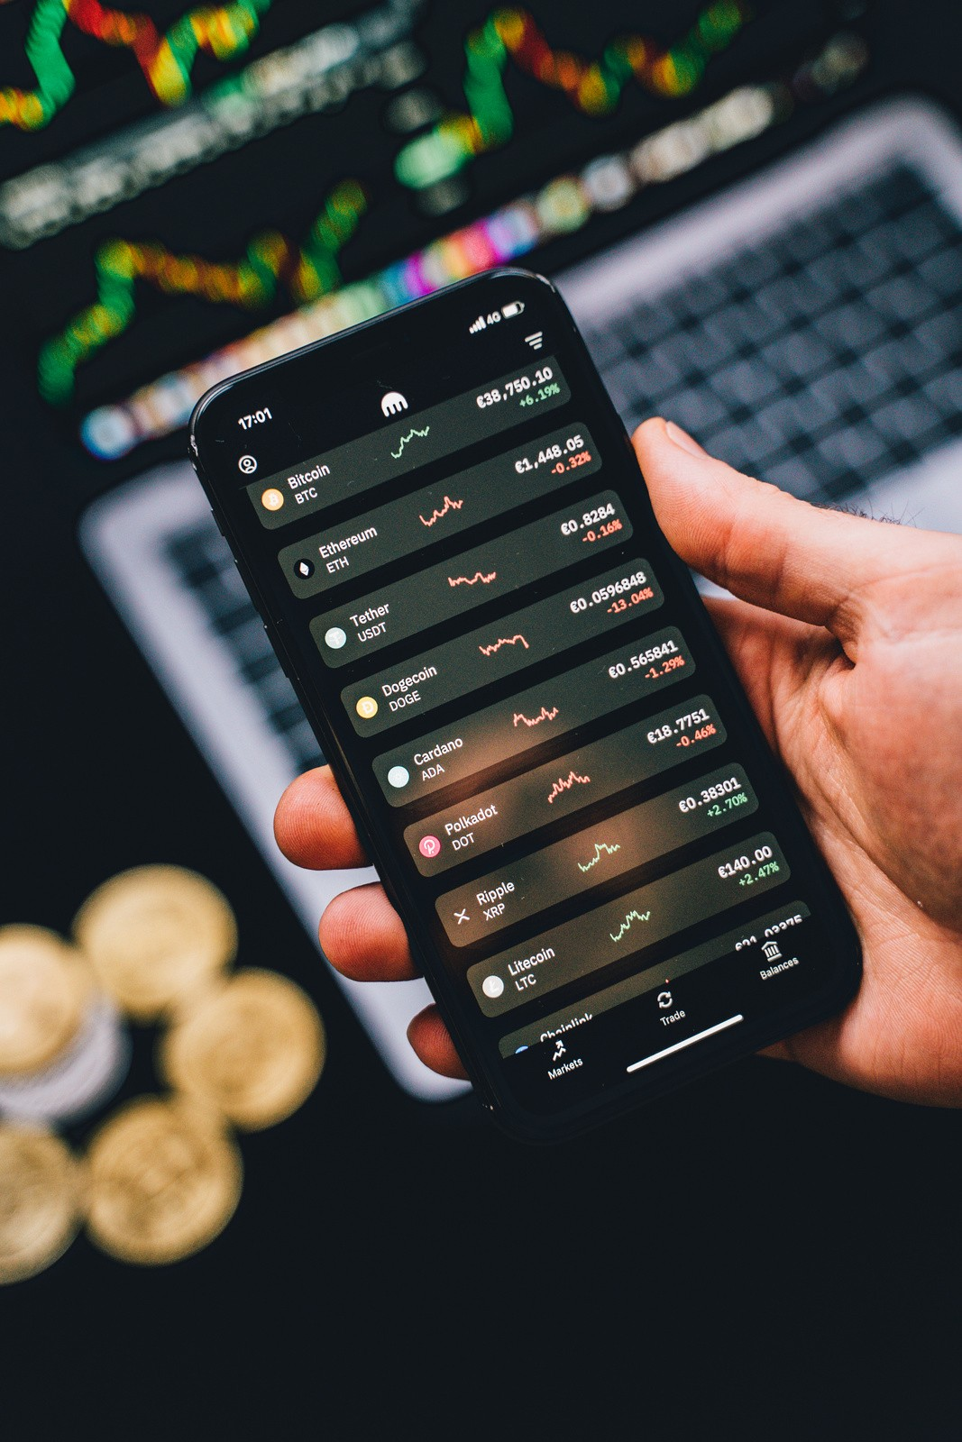
About FinTech
FinTech or Financial Technology refers to any technology that influences traditional financial processes including tax filings, payments, bank processes, and all other transactions that involve finances.

Slide 4
Was more vulnerable to theft and fraud
Banks Before FinTech
Used manual processes that can be slow, tedious, and prone to error
Provided costly and sometimes inaccessible processes to the ordinary folk
Banks with FinTech
Uses Smart Chip technology
Provides a more secure way of dealing with money Digitizes all transactions

Slide 5



A brief history of FinTech
1838
1950
1982
2009
2013
The electric telegraph was introduced for the first time.
Diner's Club released the first universal credit card.
The world was introduced to
TradePlus, the online brokerage platform.
The first version of Bitcoin
was released.
Google was first launched,
followed by Apple Pay in 2014.
Arner, Douglas. “The Evolution of Fintech: A New Post-Crisis Paradigm? By Douglas W. Arner, Janos Nathan Barberis, Ross P. Buckley :: SSRN.” Social Science Research Network, 1 Oct. 2015, papers.ssrn.com/sol3/papers.cfm?abstract_id=2676553. Accessed 5 Apr 2021.

Slide 6
FinTech segments according to transaction value
250
200
150
As of January 2021
Digital payments are leading the way followed by personal finance, alternative lending, and alternative financing.
100
50
0
0
10
20
30

Slide 7

Cybersecurity as it relates to FinTech
Why it's important to develop secure financial platforms
Whether it's data security and storage, management of transactions, or simple payment processes, it's important to prioritize cybersecurity so as not to compromise the integrity of financial platforms and services.

Slide 8

The Bumps in the Road for FinTech

Slide 9
Common FinTech Risks and Challenges
The obstacles FinTech faces in today's world
Cybersecurity
Cyber attacks collect vast amounts of personal data to carry out theft and fraudulent acts.
Data Management and Security
Consumers would like to know how their data is used, who has access to it, and what happens to it should they choose to withdraw it.
Tech Boundaries
Many places in the world are not yet fully equipped to adopt FinTech and its complex systems.

Slide 10
01
Cheaper, Easier
There are now tools that allow both companies and consumers many ways to send and receive payments minus hidden charges and extra fees.
The benefits of FinTech-driven payments
How businesses and consumers are affected
02
Better, Safer Alternatives
There's a broader array of options for consumers to carry out secure transactions, wherever they are in the world.
03
Better Transparency
Users of FinTech platforms are more involved than ever in their financial dealings and can access customer support whenever they need it.

Slide 11
The next chapter for FinTech
What's in store for companies and consumers?
As technology continues to penetrate our daily lives, we can expect FinTech to progress and include more flexible, accessible, and cost-effective channels that more and more people can take advantage of in years to come.

Slide 12
Where Fintech is now
Fintech-related Apps Solutions They Offer
PAYMENT APPS
INVESTMENT APPS
CRYPTO APPS
These apps ease the payment experience
of consumers and business owners alike
These apps provide an easy and simple avenue for individuals to invest in stocks directly
from your personal phones
These type of online apps allow individuals to use cryptocurrencies and tokens in transactions
Highlight two or more cells, right-click then choose "Merge Cells" to organize your table according to your needs!

Slide 13
How we deal with money has indeed been improved by advances in technology, encouraging us to invest in our future better.

Slide 14
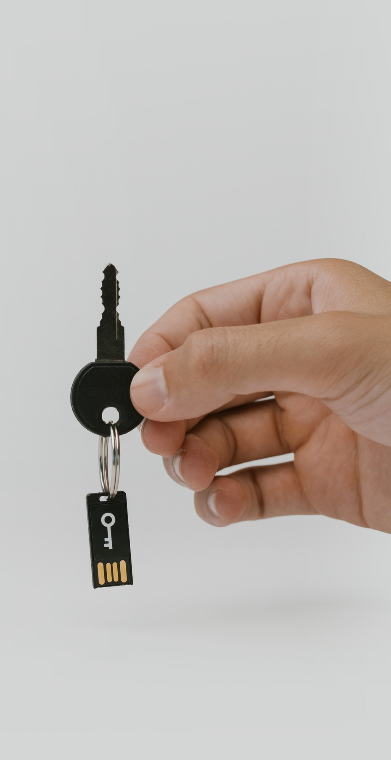
Security best practices of successful FinTech projects
01
02
03
04
05
Next-level data protection and encryption
Secure code and architecture Secure authentication
Good mobile encryption Compliance

Slide 15

At the end of the day, customer-centric fin-tech solutions are going to win.
– Giles Sutherland

Slide 16
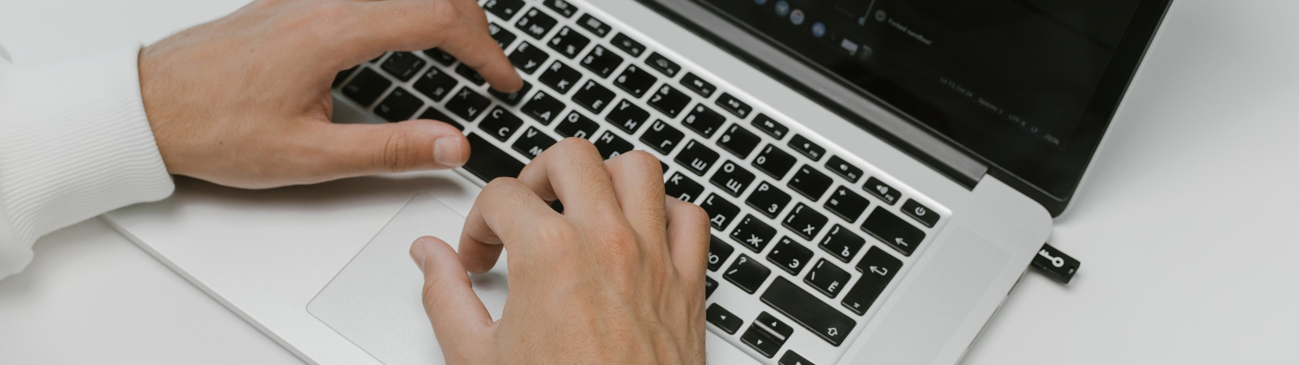
Do you have any questions?
Send it to us! We hope you learned something new.

Slide 17
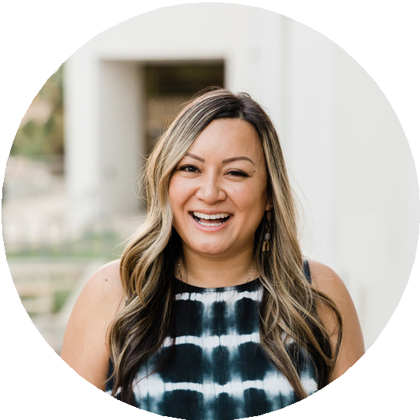
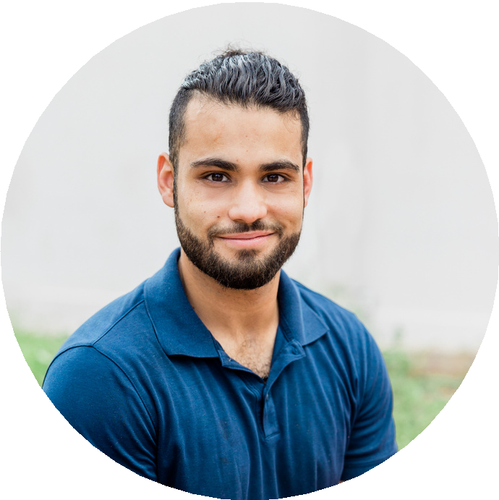

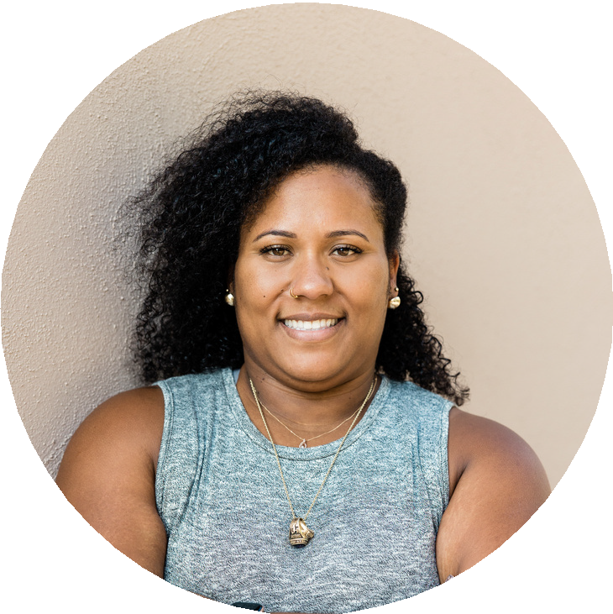
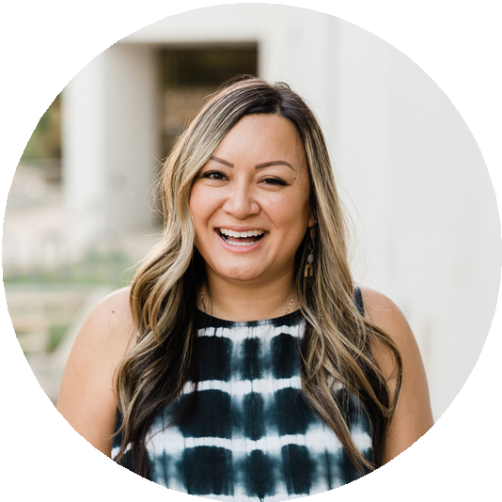
Whiteboard Page
Write a note here
Write a note here
Tip: Collaboration makes teamwork easier! Click "Share" and invite your teammates to fill this up. Use this page for bulletins, brainstorms, and other fun team ideas.
Copy a note, drag to the board, and write your ideas.
Copy a note, drag to the board, and write your ideas.
Right-click on the background of the slide, or on the thumbnail below, for the option to expand this page into a whiteboard for more space!

Slide 18
Collaborate on a Whiteboard
Add more sub-ideas
Add a related idea
Add even more sub-ideas
Add more sub-ideas
Add even more sub-ideas
Add a main topic
Add a related idea
Add a related idea
Add even more sub-ideas
Add more sub-ideas
Add a related idea
Add more sub-ideas
Tip: Collaboration makes teamwork easier! Click "Share" and invite your teammates to fill this up. Use this page for bulletins, brainstorms, and other fun team ideas.
Add even more sub-ideas
Right-click on the background of the slide, or on the thumbnail below, for the option to expand this page into a whiteboard for more space!

Slide 19
Resource Page
Use these design resources in your Canva Presentation.
Happy designing!
Don't forget to delete or hide this page before presenting.

Slide 20























Resource Page
Use these design resources in your Canva Presentation.
Happy designing!
Don't forget to delete or hide this page before presenting.

Slide 21
B for blur
C for confetti
Resource Page
Find the magic and fun in presenting with Canva
Presentations. Press the following keys while on Present mode!
D for a drumroll
M for mic drop
O for bubbles
Q for quiet
Delete or hide this page before presenting.
Any number from
0-9 for a timer
U for unveil

Slide 22
Click the Share button on the top right corner of your screen and select 'Present and Record.'
Resource Page
Presenting live not your thing? No worries! Record your Canva Presentation your audience can watch at their own pace.
Click ‘Go to recording studio,’ where you can choose the video and audio source for your video presentation.
Feel free to choose the ‘No camera’ option and record your voice only.
Start recording, and press pause in between takes if you have to.
Once you're done, download your Canva Presentation in MP4 file format or get a link to your Talking Presentation and share it with others.
Don't forget to delete or hide this page before presenting.
You can also record a video inside the editor! Go to 'Uploads' and click on 'Record yourself'.

Slide 24
Bid price：Refers to the highest price a buyer is willing to pay for a particular asset, such as a stock or commodity, at a given moment in time. In financial markets, the bid price is the price at which a market maker or a buyer is willing to purchase a security or other financial instrument. Ask price: The bid price is typically quoted alongside the ask price, which is the lowest price a seller is willing to accept for the same asset. The difference between the bid price and the ask price is called the bid-ask spread and represents the transaction cost of buying or selling the asset. Investors use bid price information to determine the current market value of an asset, and they may choose to buy or sell based on the bid price to execute their trades at the best possible price.
ASK/BID PRICE

Slide 25
Limit Order Bob and Joe posted limit orders Sell 10 etherfor$110 each Buy 10 etherfor$100 each Is stored but not executed Limit Order Book Market Order Bob really wants the ether: Give me 5 of your ether, no matter how much!“ Bob buys5 ether for $110 eachfromJoe
Limit Order vs.
Market Order

Slide 26
Volumn . Bob buys10 ether Volume is10 ether Tick Data Every single trade In contrast to e.g. candlestick chart Open, High, Low, Close (OHLC) Summarizes data from several trades First Trade, Highest Trade, Lowest Trade, Last Trade within a time interval
Volume,
Tick Data

